Slide 1

The Machine Learning Process
How do I use the axis parameter
in pandas?
Dr. Reza Dibaj

Slide 2
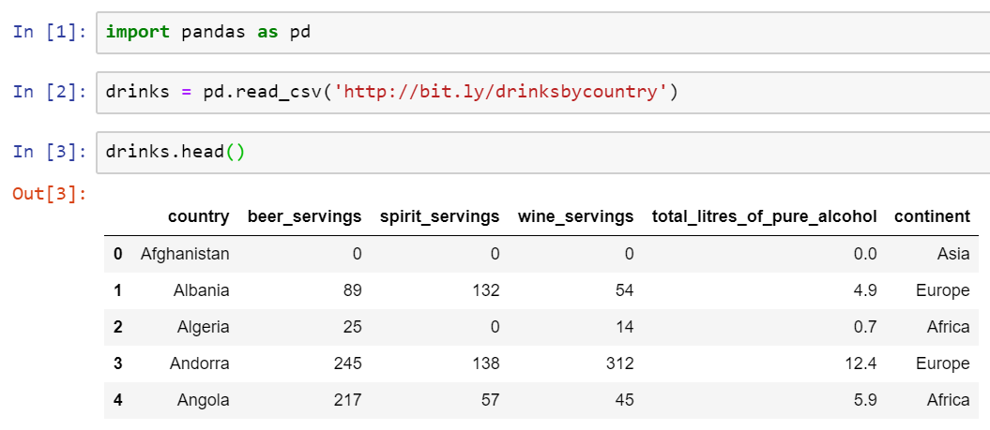
Axis parameter in pandas
Let’s pull up an example dataset as follows:
Notes:
import pandas as pd
drinks = pd.read_csv('http://bit.ly/drinksbycountry’)
drinks.head()

Slide 3

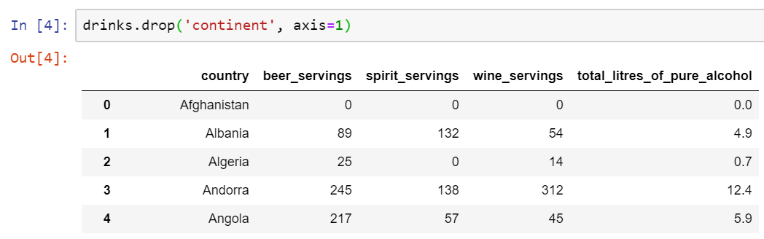
Axis parameter in pandas
What if we want to remove a column, e.g. the continent column from the DataFram?
In this case we need to use the DF drop method, as follows:
Column
Notes:
drinks.drop('continent', axis=1)

Slide 4
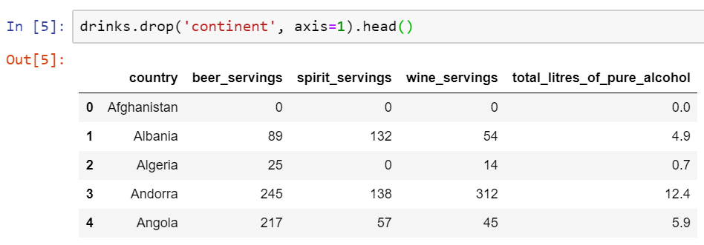

Axis parameter in pandas
If we check the first five rows by using the head() method, we can see the result as follows:
Please Note that as we did not use inplace=True the column would not be actually removed from the DataFram and only it does not show it.
Notes:
drinks.drop('continent', axis=1).head()

Slide 5
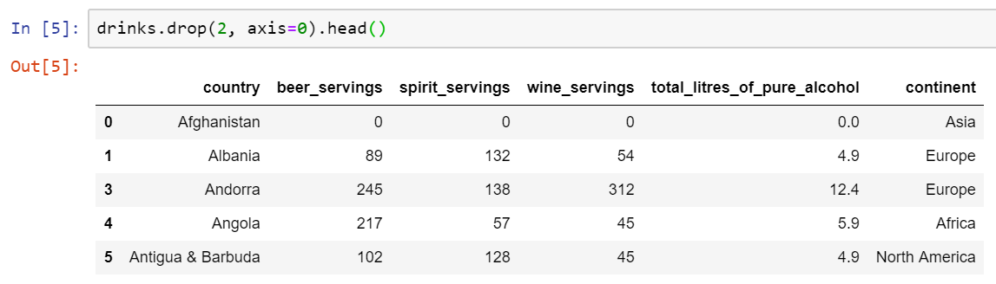
Axis parameter in pandas
The same way, we can drop row number 2 as follows:
Please Note that as we did not use inplace=True the row would not be actually removed from the DataFram and only it does not show it.
Notes:
drinks.drop(2, axis=0).head()

Slide 6


Question for Reza…
Q: Reza! It is OK for now and I could rememver it for couple of hours, but how could I remember it later, zero and one…
R: Yes! There is a shortcut!
1 → co1umn
0 → zRow

Slide 7
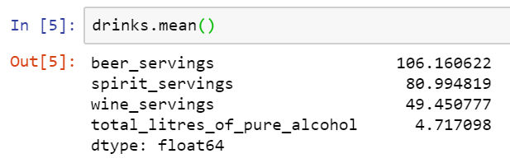
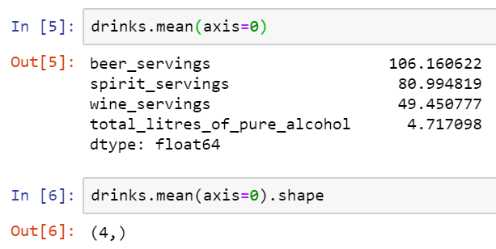

Axis parameter in pandas
Let’s try a mathematical operation, such as mean() as follows:
But Why?
OR
Default
Notes:
drinks.mean()
drinks.mean(axis=0)
drinks.mean(axis=0).shape

Slide 8

Group Discussion
Please spend a few minutes with your team members and try to explain why 0 and not 1, while it calculates the mean for each column…. right?

Slide 9

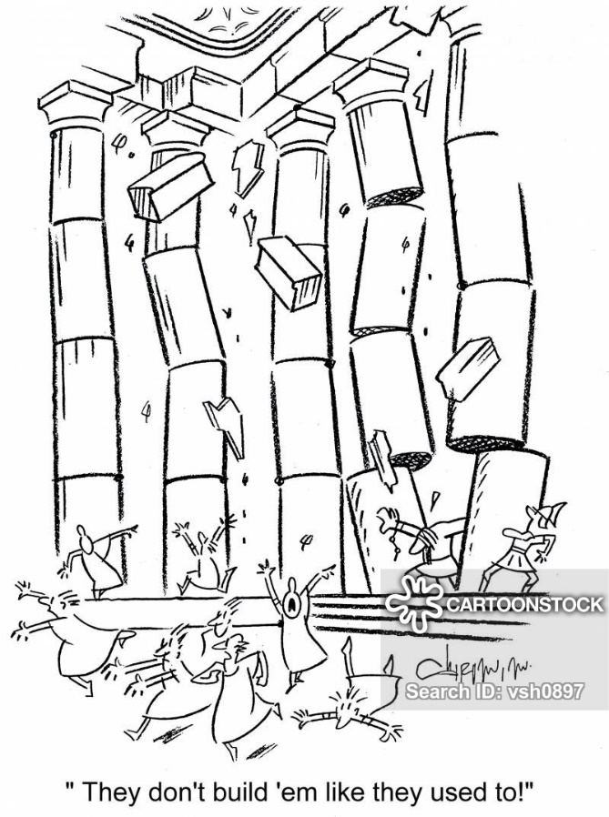
Axis parameter in pandas
We could say we create a row to calculate the mean of our DataFrame at the end…
OR
We could say we could collapse down all the rows and calculate the mean of the whole rows contents at the end…
OR
We could say if we have only one column, we literally calculate all the mean of all the rows…

Slide 10
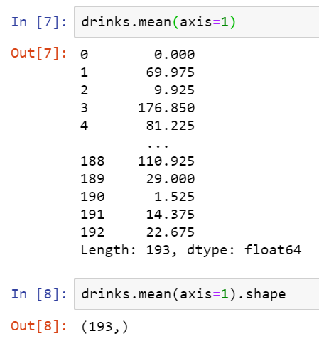
Axis parameter in pandas
And this time we calculate the mean for each row as follows:
But Why?
Notes:
drinks.mean(axis=1)
drinks.mean(axis=1).shape

Slide 11
Group Discussion
Please spend a few minutes with your team members and try to explain why 1 and not 0, while it calculates the mean for each row…. right?

Slide 12

Axis parameter in pandas
We could say we create a column to calculate the mean of our DataFrame rows at the end…
OR
We could say we could fold all the columns and calculate the mean of the whole columns contents at the end…
OR
We could say if we have only one row, we literally calculate all the mean of all the columns…

Slide 13

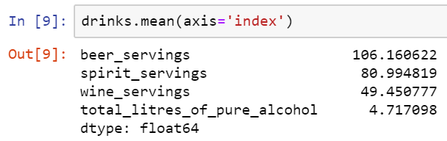
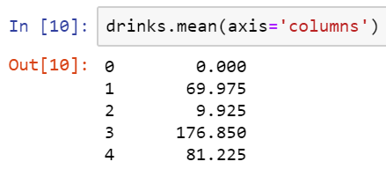
Bonus Tip
Instead of axis=0 you can say axis=‘index’
and Instead of axis=1 you can say axis=‘columns’.
Notes:
drinks.mean(axis='index')
drinks.mean(axis='columns')

Slide 14

Thank you
Question?
To be
Not to be

